Slide 1
DoorDash™
Design Sprint
Product Manager: Srinivas Katti
© 2019 Udacity. All rights reserved.

Slide 2
Set the stage
Set the stage for the Design Sprint by framing the problem
© 2019 Udacity. All rights reserved.
Notes:
[ALL PARTICIPATION]

Slide 3
Initial PRD
Background
Based on the recent study , the food delivery/hospitality industry is incurring huge operational cost and the on-time delivery of the food is also a on-going concern . To address the problem ,there is a need for automating the process entire supply chain of food delivery right from ordering the food to the last mile delivery, thereby food delivery/hospitality industry shall achieve significant reduction in the cost and also increase the productivity , thus improving the bottom line improving the topline.
According to the survey or data available, we surmise that 60% of the US population order food online(https://upserve.com/restaurant-insider/online-ordering-statistics/) and there is an immense potential in tapping this market and DoorDash as a solution is deemed fit to help our customers with their operational needs and cutting down on the operational cost. The market size for this is $212 Mn with a CAGR of 35% (
(https://www.prnewswire.com/in/news-releases/autonomous-last-mile-delivery-market-size-is-projected-to-reach-usd-84-72-billion-by-2030-at-cagr-24-4-valuates-reports-802847682.html) , which is very lucarative business to capitalize on.
DoorDash being one of the prominent player in the automated food delivery solution provider, shall bespoke the solution to cater to the customer’s requirements be it in terms of distance , re-routing and host of other features the customers intends to have .
To keep ourselves with the everchanging market demands, Doordash shall have the below new features in the product :
Delivery of the goods right from origin to the last mile delivery without human intervention or minimal human intervention in case of failure.
Build an efficient mobile or native app for the users to place the order, track the order, notifications of the delivery, secured transaction at the last mile delivery to authenticate the user.
Remote asset management and tracking

Slide 4
Understand
Create a shared understanding of the space, problem, and goals
© 2019 Udacity. All rights reserved.
Notes:
[ALL PARTICIPATION]

Slide 5
How Might We
How might we build an intuitive app for the users
How might we build a strong backend to support and the delivery system for the operations team?
How might we build robot to ask for help from the operations team, in case of failure or prognostication
How might we help help to robot to read and decipher traffic signals
How might we help robot for authenticating the user at the last mile delivery ?
How might we help robot for obstacle detection
How might we build anti collision on the road ?
How might we help robot to notify in case of theft or robbery or someone trying to attack robot?
How might we help robot to bootstrap itself if there are any failures ?
How might we help the robot re-route if the user changes the destination delivery address

Slide 6
Theme App and backend development
How might we build an intuitive app for the users
How might we build a strong backend to support and the delivery system for the operations team?
How might we build safe and secure payment systems?
How might we handle build the self healing app and backend system in case of failure
How might we provide reslience to the back-end system?
Mobile app and backend development

Slide 7
Theme
How might we provide different mechanism for user login?
How might we recover the forgot username and password options for login ?
How might we help user with secure login ?
User login theme

Slide 8
Theme
How might we help Robot to seek help from operation teams intervention?
How might we build best AI/ML model for the robot to make intelligent decision ?
How might we build re-routing feature in real-time?
How might we help Robot to auto heal itself in case of failure?
How might we build anti collision algorithm ?
Doordash autonomous delivery

Slide 9
Define
With an understanding of the problem space, create focus and align on specific outcomes for the Design Sprint
Notes:
[ALL PARTICIPATION]

Slide 10
Smart end-to-end automated food delivery system!
Yes, you read it right. smart end-to-end automated delivery system. Doordash a prominent player in the automated player in the automated food delivery system, takes pride in launching the new features to the existing product which enables users to order food online with the enhanced security, where in the user can authenticate at the last mile delivery before the food is delivered at the last mile delivery and also fancy feature to check for the tampering of the food to ensure that the food is not tampered ,all the way from the origin to last mile delivery. It is certainly a gamechanger in the field of automated food delivery systems and has competitive advantage over its customers in terms of the features which makes use of the AI/ML ,Data science technology to address the problem( Much details are not revealed by the company due to pending patents on this, as reported by company’s spokes person ).
Dashdoor undoubtedly is a disruptive product in its segment, apart from reducing the operational cost and the on-time delivery of the order, Dashdoor robots makes intelligent decisions in real time and are well equipped to auto heal itself, in worst case scenario the robot shall reach out for help to the customer care.
When we talk about the mobile app for ordering the food, it is simple and intuitive with easy navigation and can be integrated with Alexa for ordering food .However, this feature is for the premium segment customer.
Finally, to sum up, all we could say that there is a product available now , which the market was waiting for .
Please feel to write to srkatti81@gmail.com for more information.

Slide 11
Success Metrics
 | Goals | Signals | Metrics
Happiness | Intuitive design | Provide the user with elegant and simple to use app | Anyone shall be able to use this app.
Engagement | Social media/app community/blog | The more tweets and comments from the user, the better | 80% 5 star rating for the app determines the success of the product
Adoption | App download and subscribe | The user downloads and be a subscriber | 80% Referrals from the current customers and 20% from others sources
Retention | Customer subscription rate | Higher Customer subscription is the indicator of growth | At least 75% of the registered customers are active and subscribing for our grocery products
Task Success | No failure rate /No margin for error | The ordering mechanism shall happen every time the user wants to place order | The ordering app shall not fail at all. If it all it fails, the notification shall trigger and the support team reaches out to customer immediately.

Slide 12
Sketch
Generate tons of ideas, then narrow them down to two in depth solution sketches
Notes:
[ALL PARTICIPATION]

Slide 13
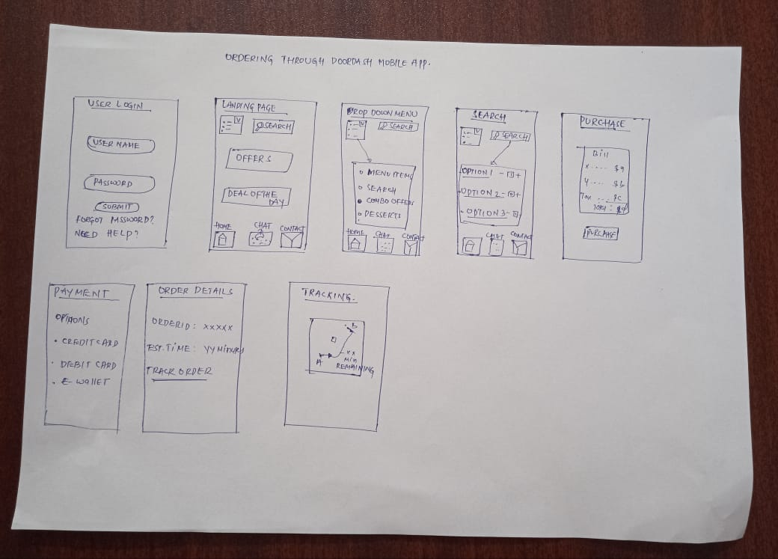
Mobile app and backend development
Upload a photo of your sketch on this slide

Slide 14
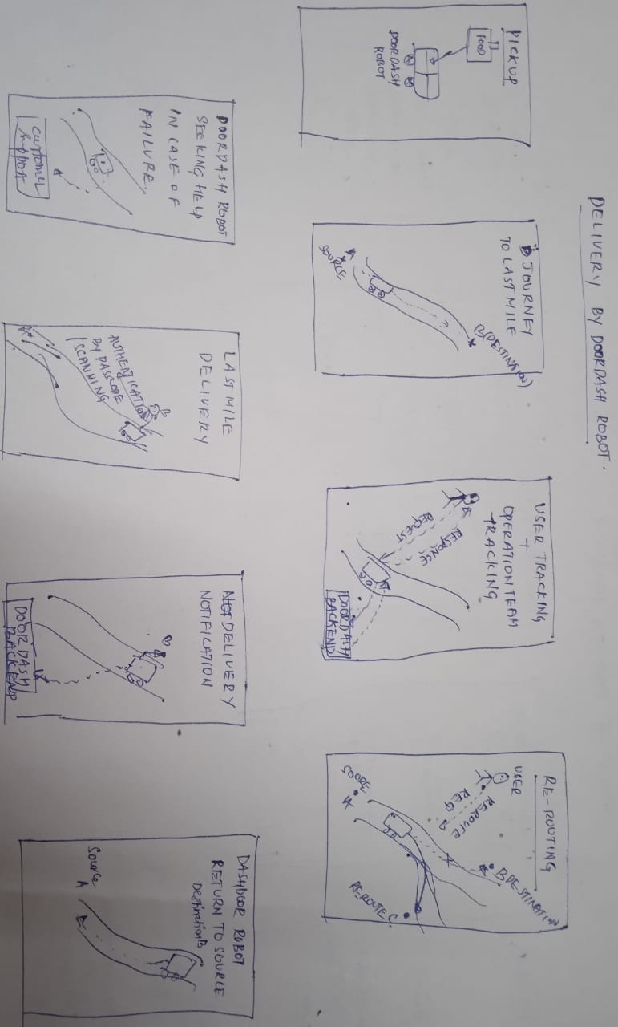
Order delivery flow by Doordash robot
Upload a photo of your sketch on this slide

Slide 15
Decide
Pick the final concept that you develop into a prototype
Notes:
[ALL PARTICIPATION]

Slide 16
Decision
Decision
Rationale | The rationale of choosing this feature is because this is the first step or the origin of the task. That is , the user places the order and then the sequence flows starts from the user. Also, this app can be prototyped quickly till it reaches robot for the delivery and then the robot shall do the needful. The rationale behind choosing this feature is because this is the very step that the user interacts with the Doordash system,also we can validate this and get user feedbacks soon. If the user/market response is not good, we are failing early and also we can save a lot of investment required to develop the hardware.
Mobile app and backend development

Slide 17
Prototype
Turn your concept into a realistic, interactive prototype that you will use to validate your assumptions and ideas
Notes:
[ALL PARTICIPATION]

Slide 18

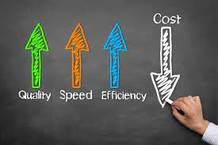
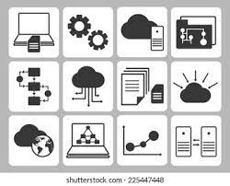
Storyboard -Dashdoor
Connoisseur foods was desperately looking to reduce the cost of the food delivery with the help of delivery robot. | Since the connoisseur foods forte was not having experience in managing the software and products, they are looking for managed services for the food delivery through complete automation. | Steve from yummy foods our existing customer, referred us to Connoisseur foods, who happens to be the friend of Connoisseur food’s owner, Steve vouched for our managed services.
Note: Dashdoor is B2B product.

Slide 19


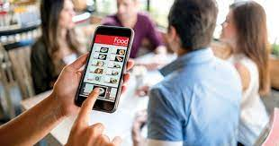
Storyboard Dashdoor – Contd…
Connoisseur wants to run the POC at their premises to see how does the solution works . | With the help of DoorDash mobile app, the operations team ordered a food, they were amazed to see the order got successfully placed with all the notifications and real time tracking . | The order next moved to the kitchen and then the ordered is ready to handover to Robot for the delivery.

Slide 20
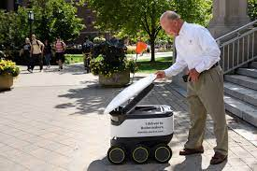
Storyboard Dashdoor – Contd…
Doordash Robot picks the delivery and delivers it to the destination address |  | .

Slide 21

Prototype
Description High level overview of the prototype What does it do? | This prototype is a pretty quick and dirty way to demonstrate the minimal feature that the doordash mobile app has , it has bare minimal features of searching and placing the order
Assumptions Any assumptions within the prototype | The prototype and the app is specifically built for food delivery The prototype is built mobile android and ios platform only. The delivery is in the vicnity of 2 miles.
Tasks What are the tasks that a user can complete in the prototype? | User can search and order the food . User can contact the support center , in case of any assistance.
Link your prototype

Slide 22
Validate
Users will go through your prototype and provide feedback on your concept. This is also an opportunity to have an engineering feasibility discussion
Notes:
[ALL PARTICIPATION]

Slide 23
Doordash delivery system
PM: Srinivas Katti
STATUS: DRAFT
Objectives
The objective of the prototype is two folds, addressing the direct customer(B2B) and the end-user( Customer’s customers) to get the feedback on the prototype and get voice of customers in real time. This way we would get feedback from the customer and also from customer’s customers which will definitely help in improvising the product.
Methodology
We are going to set to interview the users
Participants
Operations team members from the customer to make them understand about the product
End users who shall be willing to volunteer for the testing the app through play store

Slide 24
Dashdoor :Interview Sessions
Introduction
Hi , I am Srinivas Katti , Product Manager at XYZ Corporation. At the outset , I would like to thank you for your time to volunteer for to test our prototype and provide the feedback. Doordash is the end-to-end solution for automated food delivery through robots.
Background Questions
How did you find the user interface ?
How was the navigation ?
Are you able to find what you wanted to find and place order?
What might you think would be able to help the end user
Do you like the notification ?
What other means of notification do you think would be good to have ?
Is there any thing you feel that app should have, which you think is missing ?
Tasks
Try to search the food you want to delivery and see if the order was sucessful
Task 1
Go to menu and start navigation till you purchase the order
Task 2
Click on the offers and see if you can purchase your order
Wrap Up
What do you think about the navigation experience? . Any improvements / suggestions

Slide 25

User Testing: Participant 1 Key Findings
What worked well | The navigation was working well for the purchase from the main menu icon.
Where participants got stuck | If you want to go ahead and re-purchase, the app doesn’t seem to be working and it is stuck.
Other observations | The app is not foolproof and doesn’t consider all permutations and combinations of tasks, while ordering what if he wants to talk to call center ?. There is no voice support for searching and ordering the food.
Link your audio recording
Note: The google drive link of the recorded audio is provided as link.

Slide 26
Participant 1: Interview Notes
The user was able to navigate to order the food.
The app will be stuck if he wants to go ahead and the order.
All possible scenarios of ordering the food is not considered, order cancellations and sending out the notifications to user if the order is not placed, querying the user if he needs to purchase the order.

Slide 27
User Testing: Participant 2 Key Findings
Link your audio recording
What worked well | The navigation is intuitive and simple to use.
Where participants got stuck | The user is stuck, if wants to order the deal of the day and combo offer, there is no provision to ask if he wants to continue to purchase more or checkout the cart.
Other observations | The app is not bi-directional and the navigation doesn’t seem work , if we try to go and add other items to the cart and want to traverse back to the main screen for deal of the da, it is not possible ,also count of items is not shown.

Slide 28
Participant 2: Interview Notes
User has captured valid point on the count of orders, which should been captured in the prototype. Since, it was quick and dirty app, the app will have bare minimum features to start with, this was communicated to the user.

Slide 29
Handoff
© 2019 Udacity. All rights reserved.
Notes:
[ALL PARTICIPATION]

Slide 30
Updated PRD
Priority | Feature | Description
P0 | User login | The user login screen presents the user with the username and password. The username and the password is validated, if the username or password is incorrect the login fails. There is a username or password recovery mechanism provided
P0 | Ordering the food | The user has the option to search for the food and order drop menu or through search icon The app captures the information and sends out the notification to the user as well as to the Doordash backend system in real time
P1 | Customer feedback | The customer feedback is sought by giving the user the option either to record the audio feedback or to type in feedback dialogue box. The feedback is collected and is stored in the database for further analysis and decision making
P1 | Analytics | The analytics engine provides the user downloads , subscribers and the order placed on weekly/bi-weekly/monthly-weekly which is customizable. Google analytics or any other third party tools which is integrated shall provides the analytics information.
P2 | Twitter/Linkedin/facebook feeds | The feeds shall be integrated with the different social platform for evangelizing our products and creating brand awareness. The twitter, LinkedIn, Facebook API shall be integrated with the APP.

